Slide 1

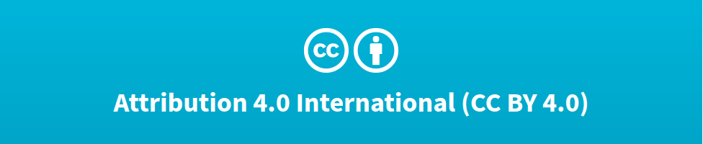

Deep Learning Design Patterns with Tensorflow 2.x
Computer Vision Workshop - Transfer Learning Version: Apr 2020
Repo: github.com/GoogleCloudPlatform/keras-idiomatic-programmer
twitter.com/andrewferlitsch

Slide 2
Transfer Learning
Overview
We will cover in this section we will cover transfer learning.
TF.Keras pre-built/trained models
TF.Hub pre-built/trained models
Transfer Learning
Similar Tasks
Distinct Tasks
Domain Weight Transfer

Slide 3
TF.Keras Pre-built/Trained Models
The TF.Keras framework comes with a number of pre-built models, which you can use either as-is to train a new model, or modify and/or fine-tune for transfer learning.
Sequential CNN | VGG16, VGG19
Residual CNN | ResNet, ResNetV2
Wide Residual CNN | ResNeXt, InceptionV3, InceptionResNetV2
Alternatively Connected CNN | DenseNet, Xception, NASNet
Mobile CNN | MobileNet, MobiletV2

Slide 4
TF.Keras Pre-built/Trained Models
The pre-built Keras models are imported from the keras.applications module. Below are some examples:
from tensorflow.keras.applications import VGG19 from tensorflow.keras.applications import ResNet50 from tensorflow.keras.applications import InceptionV3 from tensorflow.keras.applications import InceptionResNetV2 from tensorflow.keras.applications import DenseNet121 from tensorflow.keras.applications import DenseNet169 from tensorflow.keras.applications import DenseNet201 from tensorflow.keras.applications import Xception from tensorflow.keras.applications import NASNetLarge from tensorflow.keras.applications import NASNetMobile from tensorflow.keras.applications import MobileNet

Slide 5
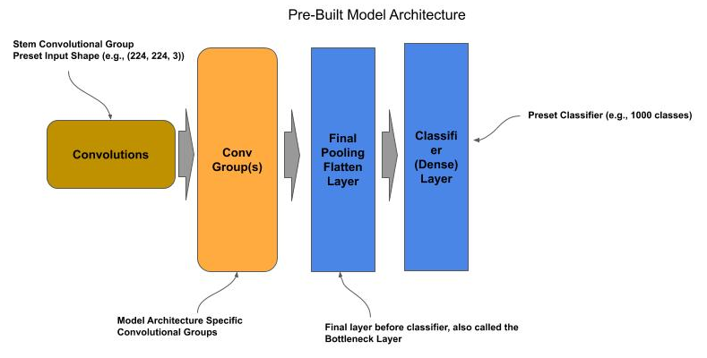
Base Model
By default, the TF.Keras pre-built models are complete but untrained (i.e., the weights and biases are randomly initialized). Each untrained pre-built model is configured for a specific input shape (see documentation), and number of output classes.

Slide 6
Base Model - Compiling
The pre-built models do not have an assigned loss function and optimizer. Prior to using them, one must issue the compile() method to assign the loss, optimizer and performance measurements.
from tensorflow.keras.applications import ResNet50 model = ResNet50() model.compile(loss='categorical_crossentropy', optimizer='adam', metrics=['accuracy']) # Now train the model

Slide 7
Pre-Trained
All of the pre-built models come with weights and biases pre-trained from ImageNet 2012 dataset; which is a dataset of 1.2 million images across 1000 classes. If your need is simply to predict if an image is within the 1000 classes of ImageNet dataset, then one can use the pre-trained pre-built models as-is.
The preprocess_input() method will preprocess the image according to the method used by the pre-built ResNet model.
The decode_predictions() method will map label identifiers back to the class name.
The pre-built ResNet model is instantiated with Imagenet weights.
An image of an elephant is read in by openCV and then resized to (224, 224) to fit the input shape of the model.
The image is then preprocessed using the model’s preprocessed_input() method.
The image is then reshaped into a batch.
The image is then classified by the model using the predict() method.
The top 3 predicted labels are then mapped to their class names using decode_predictions() and printed. In this example, one might see ‘African Elephant’ as the top prediction.
from tensorflow.keras.applications import ResNet50 from tensorflow.keras.applications.resnet import preprocess_input, decode_predictions model = ResNet50(weights='imagenet') image = cv2.imread('elephant.jpg', cv2.IMREAD_COLOR) image = cv2.resize(image, (224, 224), cv2.INTER_LINEAR) image = preprocess_input(image) image = image.reshape((-1, 224, 224, 3)) predictions = model.predict(image) print(decode_predictions(predictions, top=3))

Slide 8
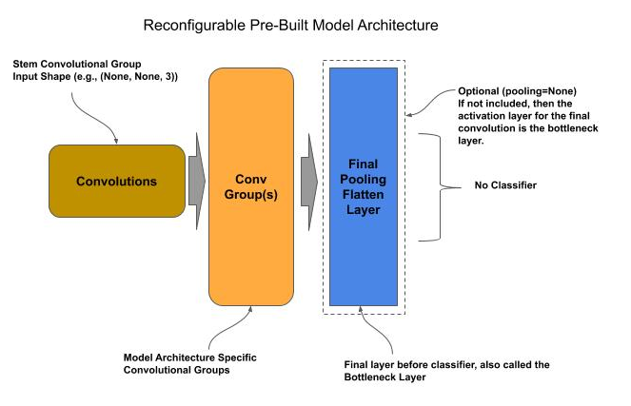
New Classifier
The final classifier layer in all the pre-built models can be removed and replaced with a new classifier. The new classifier can then be used to train the pre-built model for a new dataset and set of classes.

Slide 9
Get Model w/o Classifier
When instantiating an instance of a pre-built model, you would set the parameter include_top to False to get an instance without the classifier. Additionally, when the include_top=False, one can specify a different input shape of the model with the parameter input_shape.
One can also drop the final flattening/pooling layer, referred to as the bottleneck layer, to replace with your own by setting the parameter pooling=None.
from tensorflow.keras.applications import ResNet50 from tensorflow.keras.layers import Dense model = ResNet50(include_top=False, input_shape=(100, 100, 3), pooling='avg')
No top layer. Input shape set to (100, 100, 3)

Slide 10
Add New Classifier to Model
To add the classifier:
Add a dense layer with twenty nodes and a softmax activation function as the top layer.
The last (output) layer in the ResNet model is model.outputs.
We bind the model.outputs as the input to the dense layer.
Build the model, where the input is the input to the ResNet model, which is models.input.
Compile the model.
Add dense layer and bind the input to the last output of the model.
outputs = Dense(20, activation='softmax')(model.output) model = Model(model.input, outputs) model.compile(loss='categorical_crossentropy', optimizer='adam', metrics=['accuracy'])
Build the new model

Slide 11
Add Bottleneck Layer to Model
In some cases, one might want to replace this layer with one’s own custom final pooling/flatten layer. In this case, one either specifies the parameter pooling=None or not specify it, which is the default setting.
model = ResNet50(include_top=False, input_shape=(100, 100, 3), pooling=None) outputs = Flatten()(model.output) outputs = Dense(20, activation='softmax')(outputs) model = Model(model.input, outputs) model.compile(loss='categorical_crossentropy', optimizer='adam', metrics=['accuracy'])
Add bottleneck layer and bind the input to the last output of the model.
Add the classifier layer.

Slide 12
TF.Hub Pre-built/Trained Models
The Tensorflow open-source maintains its own repository of pre-built models, which is located at TF.Hub.
To use TF.Hub you will need to first install the tensorflow_hub python module.
!pip install tensorflow_hub
In your python script, you access the TF.Hub by importing the tensorflow_hub module.
import tensorflow_hub as hub

Slide 13
TF.Hub Pre-built/Trained Models
In this section we will just cover the pre-built models for image classification. TF.Hub provides two versions of each model, which are described as:
Modules to do image classification with the particular classes that the module has been trained for.
Modules to extract image feature vectors, (a.k.a. "bottleneck values") for use in custom image classifiers.
The former (1) is the same as the pre-trained models and the later (2) is the same as the new classifier we described for TF.Keras.

Slide 14
TF.Hub Pretrained
TF.Hub pretrained models can be loaded as TF 2.0 SavedFormat, TFLite (mobile), TF.js (browser) and Coral (edge/IoT). To load a SavedFormat model, you will do the following:
Get the URL to the image classifier model in the TF Hub repository.
Retrieve the model data from the repository specified by the url with hub.KerasLayer().
Construct a TF.Keras SavedModel from the model data using the TF.Keras Sequential API.
Specify the input shape to (224, 224, 3) which matches the input shape the pre-trained model was trained on (ImageNet).
model_url = "https://tfhub.dev/google/imagenet/resnet_v2_50/classification/4" model = tf.keras.Sequential([hub.KerasLayer(model_url, input_shape=(224,224,3))])

Slide 15
TF.Hub Pretrained - Predictions
One can now use the model to do predictions (inference).
Get the label (class names) information for ImageNet so we can convert the predicted label (numeric index) to the class name.
Preprocess the images to predict:
Resize the image input to match the input of the model: (224, 224, 3).
Normalize the image data: divide by 255.
Invoke the predict() for the images.
Use np.argmax() to return the label index of the highest probability.
Convert the predicted label index to the corresponding class name.
path = tf.keras.utils.get_file('ImageNetLabels.txt','https://storage.googleapis.com/download.tensorflow.org/data/ImageNetLabels.txt') imagenet_labels = np.array(open(path).read().splitlines()) import cv2 import numpy as np data = cv2.imread('apple.png') data = cv2.resize(data, (224, 224)) data = (data / 255.0).astype(np.float32) p = model.predict(np.asarray([data])) y = np.argmax(p) print(imagenet_labels[y])

Slide 16
TF.Hub New Classifier
For building new classifiers for pre-trained models, one loads the corresponding model url denoted as the feature vector version of the model. This version loads the pre-trained model without the model top (classifier).
Below is an example implementation of loading a feature vector version of a pre-trained ResNet V2 model:
Get the URL to the image classifier model in the TF Hub repository.
Retrieve the model data from the repository specified by the url with hub.KerasLayer().
Specify a new input shape of (32, 32, 3) for CIFAR-10 dataset
f_url = "https://tfhub.dev/google/imagenet/resnet_v2_50/feature_vector/4" f_layer = hub.KerasLayer(f_url, input_shape=(32,32,3))

Slide 17
TF-Hub New Classifier
Below is an example implementation of constructing a new classifier in SavedModel format:
Create a SavedModel using the Sequential API.
Specify the feature vector version of the pre-trained ResNet V2 as the model bottom.
Specify a dense layer of 10 nodes (one per CIFAR-10 class) as the model top.
Compile the model.
model = tf.keras.Sequential([ f_layer, Dense(10, activation='softmax') ]) model.compile(loss='sparse_categorical_crossentropy', optimizer='adam', metrics=['acc'])

Slide 18
Transfer Learning
Transfer learning is where one uses pretrained models for one task and retrains the classifier and/or fine-tune layers for a new task, similar to what was discussed previously for New Classifier.
There are two general approaches to transfer learning:
Similar Tasks (Image Domains)
Distinct Tasks

Slide 19
Similar vs. Distinct Tasks
When deciding on the approach, we look at the similarity of the source (pre-trained) domain of images and the destination (new) domain.
The more similar, the more of the existing bottom layers we can reuse without retraining.
For example, if one had a model trained on fruits, it’s likely that all of the bottom layers of the pretrained model can be reused without retraining for building a new model to recognize vegetables.

Slide 20
Similar Tasks
When the source and destination domains have this high level of similarity, we generally can replace the existing topmost classifier layer with a new classifier layer, freeze the lower layers and train only the classifier layer.
Since we don’t need to learn the weights/biases for the other layers, we can generally train a model for the new domain with substantially less data and fewer epochs.
Transfer learning between similar source and destination domains provides the ability to train with substantially smaller datasets.
Each class (label) is 10% as big as in the source dataset.
Each class (label) has at least 100 images.

Slide 21
Similar Tasks - Training
We modify the code to freeze all the layers preceding the topmost classifier layer prior to training. Freezing prevents the weights/biases of these layer(s) from being updated (retrained) during training of the classifier (topmost) layer.
In Keras, each layer has the property trainable, which defaults to True.
model = ResNet50(include_top=False, pooling='avg', weights='imagenet') for layer in model.layers: layer.trainable = False output = Dense(20, activation='softmax')(model.output) model = Model(model.input, output) model.compile(loss='categorical_crossentropy', optimizer='adam', metrics=['accuracy']) model.fit(x_train, y_train, …..
Use a pre-built model with pre-trained weights/biases (ImageNet 2012),.
Drop the existing classifier from the pre-built model (topmost layer).
Freeze the remaining layers.
Add a new classifier layer.
Train the model through transfer learning.

Slide 22
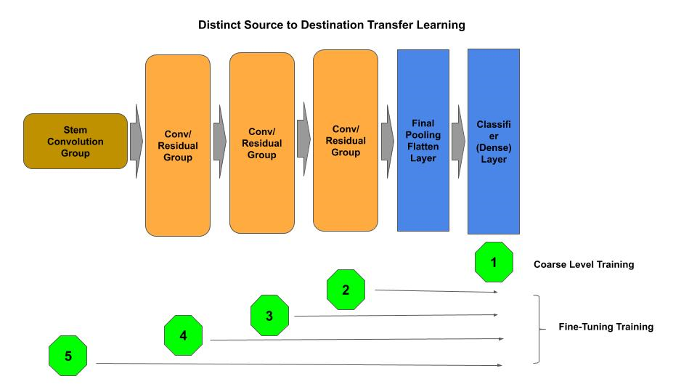
Distinct Tasks
When the source and destination domain of the image datasets are non-similar, one starts with the same steps as in the similar task approach above, but then follows up with fine-tuning the bottom layers.

Slide 23
Distinct Tasks - Training
Add a new classifier layer and freeze the remaining bottom layers.
Train the new classifier layer for the target number of epochs.
Repeat for fine-tuning:
Unfreeze the next bottom-most convolutional group (moving in direction of top to bottom).
Train for a few epochs to fine-tune.
Once the convolutional groups are fine-tuned:
Unfreeze the convolutional stem group.
Train for a few epochs to fine-tune.
model = ResNet50(include_top=False, pooling='avg', weights='imagenet') for layer in model.layers: layer.trainable = False output = Dense(20, activation='softmax')(model.output) model = Model(model.input, output) model.compile(loss='categorical_crossentropy', optimizer='adam', metrics=['accuracy']) model.fit(x_data, y_data, batch_size=32, epochs=50, validation_split=0.2)

Slide 24
Distinct Tasks - Training
Add a new classifier layer and freeze the remaining bottom layers.
Train the new classifier layer for the target number of epochs.
Repeat for fine-tuning:
Unfreeze the next bottom-most convolutional group (moving in direction of top to bottom).
Train for a few epochs to fine-tune.
Once the convolutional groups are fine-tuned:
Unfreeze the convolutional stem group.
Train for a few epochs to fine-tune.
first_conv2d = True for layer in model.layers: if type(layer) == layers.convolutional.Conv2D: if first_conv2d == True: stem = layer first_conv2d = False else: conv2d.append(layer) elif type(layer) == layers.merge.Add: groups.insert(0, conv2d) conv2d = [] for i in range(1, len(groups)): for layer in groups[i]: layer.trainable = True model.compile(loss='categorical_crossentropy', optimizer='adam',metrics=['accuracy']) model.fit(x_data, y_data, batch_size=32, epochs=5)

Slide 25
Distinct Tasks - Training
Add a new classifier layer and freeze the remaining bottom layers.
Train the new classifier layer for the target number of epochs.
Repeat for fine-tuning:
Unfreeze the next bottom-most convolutional group (moving in direction of top to bottom).
Train for a few epochs to fine-tune.
Once the convolutional groups are fine-tuned:
Unfreeze the convolutional stem group.
Train for a few epochs to fine-tune.
stem.trainable = True model.compile(loss='categorical_crossentropy', optimizer='adam', metrics=['accuracy']) model.fit(x_data, y_data, batch_size=32, epochs=5, validation_split=0.2)

Slide 26
Domain Specific Weights
In the previous examples, we initialized the frozen layers of the model with weights learned from the ImageNet 2012 dataset. One may desire to have pre-trained weights from a specific domain, other than the ImageNet 2012.

Slide 27
Domain Specific Weights
Instantiate an uninitialized ResNet50 model without the classifier and pooling layer, which we designate as the base model.
Save the base model architecture for later reuse in transfer learning (‘produce-model’).
Add a classifier (Flatten and Dense layers) and train for a specific (source) domain (e.g., produce).
Save the weights for the trained model (‘produce-weights’).
Load the base model architecture (‘model-produce’), which does not contain the classifier layer.
Initialize the base model architecture with the pretrained weights for the source domain (‘model-produce’).
Add a classifier for the new similar domain.
Train the model/classifier for the new similar domain.
model = ResNet50(include_top=False, pooling=None, input_shape=(100, 100, 3)) model.save('produce-model') output = Flatten(name='bottleneck')(model.output) output = Dense(20, activation='softmax')(output) # do training here model.save_weights('produce-weights') model = load_model('produce-model') model.load_weights('produce-weights') output = Flatten(name='bottleneck')(model.output) output = Dense(20, activation='softmax')(output) model = Model(model.input, output) model.compile(loss='categorical_crossentropy', optimizer='adam', metrics=['accuracy']) # train the new model for a new dataset

Slide 28
Domain Transfer Weight Initialization
Another form of transfer learning is the transfer of domain specific weights to use as weight initialization in a model one will otherwise fully retrain.
In this case, one is trying to improve on using an initializer based on a random weight distribution algorithm (e.g., He-Normal for ReLU activation functions) versus using the lottery hypothesis or warmup for numerical stabilization.
Transferring of domain specific weights is a one-shot weight initialization approach. Ideally during initial training, the weights of the model will:
Point in the general right direction for convergence.
Be over generalized to prevent diving into an arbitrary local optima.
Be used as the initialization weights for a single (one-shot initialization) training session which will converge on the best local optima.

Slide 29
Domain Transfer Weight Initialization
The pre-training steps for this form of weight initialization are:
Instantiate a model, with a random weight distribution (e.g., He-Normal).
Use a high level of regularization to prevent fitting to the data and small learning rate.
Run a few epochs.
Save the weights.
model = ResNet50(include_top=False, pooling=’avg’, input_shape=(100, 100, 3)) model.save('base_model') output = layers.Dropout(0.75)(model.output) output = layers.Dense(20, activation='softmax')(output) model = Model(model.input, output) # do pre-training here for a few epochs (e.g., 5 epochs) # with small learning rate model.save_weights('weights-init')

Slide 30
Domain Transfer Weight Initialization
Then, start a full training session using the saved weights.
model = load_model('base_model') model.load_weights('weights-init') output = Dense(20, activation='softmax')(model.output) model = Model(model.input, output) model.compile(loss='categorical_crossentropy', optimizer='adam', metrics=['accuracy']) # train the new model

Slide 31
THANK YOU FOR WATCHING
Google Cloud AI Developer Relations AI Training

Slide 32
Transfer Learning - Lab Exercise #XX
Optional Code Lab - Get Familiar with Transfer Learning
Deep Learning Design Patterns - Workshop - Chapter 7.ipynb

